Slide 1

Natural Language Processing
Rohit Kate
BERT – Part 1

Slide 2
Reading
Chapter 9 (skip code) & Section 10.2 from Textbook 1

Slide 3
Original Paper
Devlin, Jacob, Ming-Wei Chang, Kenton Lee, and Kristina Toutanova. "BERT: Pre-training of deep bidirectional transformers for language understanding." arXiv preprint arXiv:1810.04805 (2018).
https://arxiv.org/abs/1810.04805
Later appeared in NAACL-HLT 2019
More than 84,000 citations since 2018
Has been transformational in NLP

Slide 4
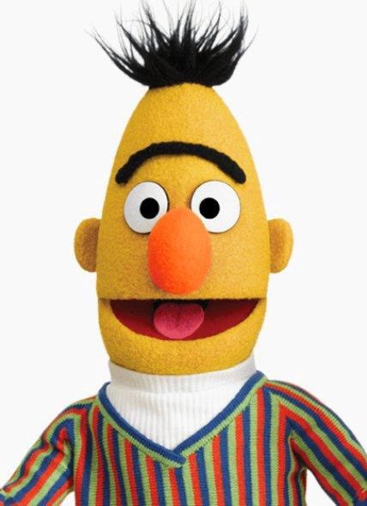
BERT
Bidirectional Encoder Representations from Transformers
Uses only the encoder part of the transformer architecture
Generates context-based representations of the input
The new representation can then be used for various NLP tasks
Pre-trained for language modelling tasks, can be then fine-tuned for other tasks

Slide 5
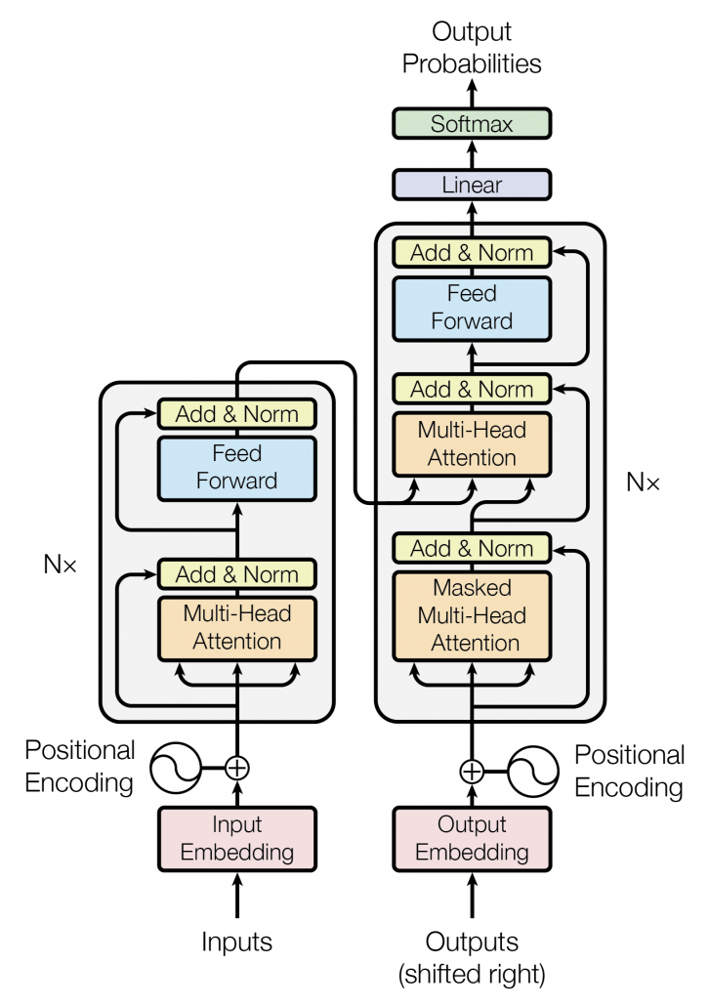
Big Picture
Task Output
Fine-tuned
More layer(s)
New Representation
Pre-trained

Slide 6
A New Learning Paradigm in NLP
Traditionally, for each NLP task:
Task-specific training data was prepared (typically small)
Machine learning model was trained
Trained model could do that task

Slide 7
A New Learning Paradigm in NLP
Traditional learning in NLP
Training data1
Model1
NLP Task1
Training data2
Model2
NLP Task2
Training data3
Model3
NLP Task3
Training data4
Model4
NLP Task4

Slide 8
A New Learning Paradigm in NLP
With BERT:
Pre-trained to learn “general language” on massive amounts of text through self-supervision
Fine-tuned on a specific NLP task using the task-specific training data (typically small)

Slide 9
A New Learning Paradigm in NLP
Learning in NLP using BERT
LARGE text corpus
Training data1
Fine-tuned Model1
NLP Task1
Training data2
Fine-tuned Model2
NLP Task2
Pretraining
Pretrained BERT
Training data3
Fine-tuned Model3
NLP Task3
Training data4
Fine-tuned Model4
NLP Task4

Slide 10
Transfer Learning
This is also known as transfer learning
Transfer/adapt the learned knowledge from one task to another
For example, tennis → racquetball
No need to learn from scratch
A lot of language related knowledge is picked up during pre-training
Word related knowledge
Grammar related knowledge
This is later useful for a specific task

Slide 11
Special Tokens
BERT uses a few extra tokens in its input representation
[CLS]: Classification token: First token of every sequence
Its new representation is used as an aggregate sequence representation (for e.g., used to classify the sequence)
[SEP]: Separation token: Used to separate sentences (“sentence” could mean arbitrary span of contiguous text that is task-appropriate)
[PAD]: Padding token: Used to fill up rest of the sequence when they need to be of a certain lengths
I arrived late. All had left.
[CLS] I arrived late . [SEP] All had left .
[CLS] I arrived late . [SEP] All had left . [PAD] [PAD]

Slide 12
Pre-Training BERT Model
The weights of the encoders need to be learned via performing some task(s)
Learn to generate some meaningful representation
BERT is pre-trained on the following two “fake” tasks
Masked language modelling
Next Sentence Prediction
Neither of these tasks require any annotated data
Self-supervised learning
Just requires a large collection of text documents
Several gigabytes of text
Easy to obtain
Helps it learn general aspects of language

Slide 13
Masked Language Modelling
Randomly mask 15% of words in the corpora and train the network to predict them
Classification task with all words in the vocabulary as classes
Unlike the language modeling task that predicts the next word (that is called causal LM, and is useful for generating text)
In masked LM, the emphasis is not on generating text but to learn general aspects of a language
Words from both directions are used for prediction - bidirectional
?
?
I [MASK] late. All had [MASK].

Slide 14
Masked Language Modelling
Also known as cloze test in linguistics
Requires good understanding of the language
Semantic relationships
I poured coffee in the ____ .
Grammatical knowledge
They ____ happy.
Word associations
The balloon ____ in the mid air.
Also requires some common knowledge
The sun rises in the ____.

Slide 15
Masked Language Modelling
... arrived:0.5 was: 0.3 cat: 0.01 …
Softmax
NN
T_{[CLS]} T_{I} T_{[MASK]} T_{late} T. T_{[SEP]} T’_{All} T’_{had} T’_{[MASK]} T’. T’_{[SEP]}
Encoders
[CLS] I [MASK] late . [SEP] All had [MASK] . [SEP]

Slide 16
Masked Language Modelling
However, the NLP tasks on which BERT will be applied (fine-tuned) will not have any [MASK] tokens
To mitigate mismatch between pre-training and fine-tuning data, not all masked tokens (to be predicted) are replaced by [MASK] token
80% are replaced by [MASK]
10% are replaced by random tokens
10% are kept as original tokens
If a word to be masked got split in subwords then all the subwords are masked

Slide 17
Next Sentence Prediction (NSP)
While masked LM helps in learning some aspects of language, it does not help learn beyond a sentence
Some NLP tasks require ability to see connections between sentences, e.g. question-answering, textual entailment
Hence they included another pre-training “fake” task at sentence level

Slide 18
Next Sentence Prediction (NSP)
Given two sentences A and B, is B next to A
Binary classification: IsNext or NotNext
The dog barked loudly. The cat was woken.
IsNext
The cat jumped over the dog. The sun was bright.
NotNext
Data can be trivially generated form a corpus
Self-supervised learning
Two adjacent sentences form positive example (IsNext; 50% examples)
A sentence and a random sentence form negative example (NotNext; 50 examples)
Note: Attention will be also between words across the sentences (cross attention)

Slide 19
Next Sentence Prediction (NSP)
Designed for understanding relationship between two sentences
Useful for NLP tasks such as question-answering
Not captured by language modelling tasks

Slide 20
Next Sentence Prediction
IsNext :0.9 NotNext 0.1
Softmax
NN
T_{[CLS]} T_{I} T_{[MASK]} T_{late} T. T_{[SEP]} T’_{All} T’_{had} T’_{[MASK]} T’. T’_{[SEP]}
Encoders
[CLS] I [MASK] late . [SEP] All had [MASK] . [SEP]

Slide 21
Pre-Training
Pre-training Data:
BooksCorpus (800M words; free novel books)
Wikipedia (2500M words)
The model is trained on both the pre-training tasks simultaneously
Minimizes loss on both the tasks

Slide 22
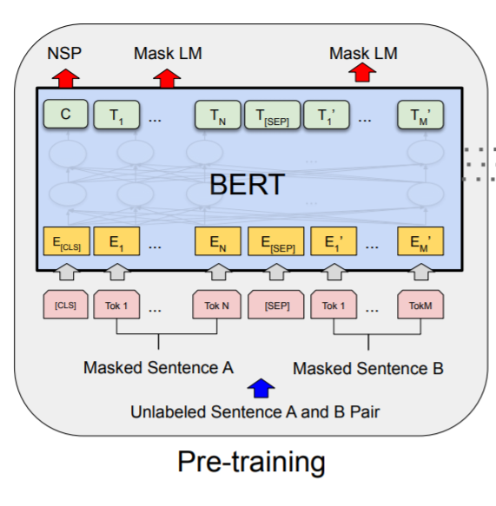
Pre-Training
Taken from Figure 1 of the paper.

Slide 23
BERT Input Representation
The input tokens use three embeddings:
Token embedding
Segment embedding: An indicator to distinguish between two sentences
Position embedding: To indicate positions of tokens in the sequence
The three embeddings are summed to get the input representation
Figure 2 from the paper.

Slide 24
BERT Input Representation
Token embeddings:
These are learned in the embedding layer
Segment embeddings:
To distinguish between segments (e.g. first sentence vs. second sentence)
These could be something simple, e.g. all 0s for the first segment and all 1s for the second segment
Especially important for the NSP task
Position embeddings:
Same as in the transformer architecture

Slide 25
Word-Level Tokenization
Ordinary tokenization: word-by-word has the disadvantage of out-of-vocabulary (OOV) words
Words seen during testing which were not seen during training, usually rare words
Normally handled using the special “unknown” (UNK) token
Disadvantages:
Applications like machine translation and conversational engines cannot handle it
“I don’t know” is not a good response
Blankets the actual word
Treats all unknown words as the same

Slide 26
Character-Level Tokenization
A possible alternate is character-by-character tokenization
No problem with OOV
All characters are known!
Disadvantages
Very inefficient
Short sentence becomes a long sequence of characters
Low level processing, will have to learn that t-h-e as a sequence means

Slide 27
Subword Tokenization
Can be do something in between the two extremes of word-level and character-level tokenization?
BERT uses a subword based tokenization scheme
Relatively new
Subword => smaller than words
dishwasher → dish + wash + er
The subwords are statistically driven rather than linguistically
Some subwords may not be meaningful

Slide 28
Subword Tokenization
If a word is in the vocabulary, then use it
Otherwise, split it into two or more frequent subwords such that all of them are in the vocabulary
Vocabulary contains individual characters hence a split is always possible
The subsequent subwords are indicated by ## symbol
Playing -> play + ##ing

Slide 29
Subword Tokenization
How to build the vocabulary?
There are multiple methods, most widely used is byte-pair encoding (BPE)
BERT used a different but related method: WordPiece tokenization
Vocabulary is built from characters up by merging pairs in the current vocabulary which occur most frequently in a corpus, till a desired vocabulary size is reached (30K in BERT)

Slide 30
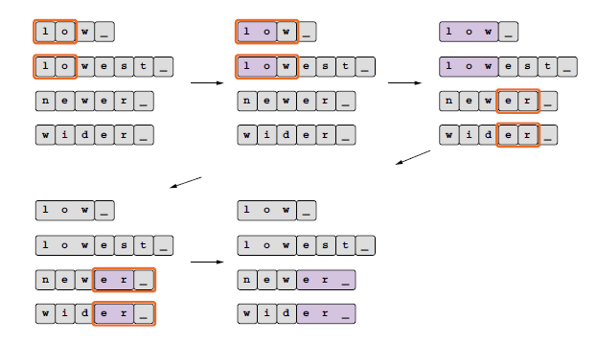
Subword Tokenization
Byte-pair encoding method:
Current vocabulary: low, _, e, s,
t, n, w, er_, w i
Adapted Figure 10.6 from Textbook1.

Slide 31
Subword Tokenization
Advantages
No OOV problem!
Unknown words are simply split into known subwords
Unknown word is not blindly blanketed
Each unknown word is treated differently
Efficient
Unlike character-level tokenization, the sequence does not become too long and not too low-level
Complete control over vocabulary level
Also used in transformers

